Slide 1
SystemLink – like a boss
Mark Lee
GDevCon Sydney, October 25 2023
With apologies to Dreamworks, New Line Cinema, SEGA, Fox, NBC, BBC…

Slide 2
About Me
Originally from Poole Harbour on the South Coast UK
Started with LabVIEW in 2005 v7.1 on a PXI 3-axis motion project …
Self-taught ☹
I was an NI AE from 2005-early 2007
Worked with alliance partners in Sydney and the UK until 2013
Moved permanently to Sydney in 2013
Worked for Cochlear and Finisar plus Sciware and EnvisEng
3 Aussie kids, English cat, English wife

Slide 3
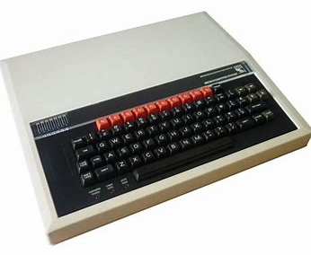
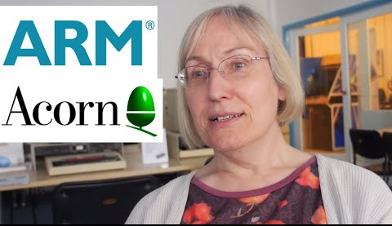
#ourgiantsarefemale
Sophie Wilson, Computer Scientist, Cambridge UK
Joined Acorn Computers in the UK in 1978
Designed the BBC Micro and Acorn.
She designed instructions for the first Reduced Instruction Set Computers processor, the Acorn Risc Machine (ARM).
ARM became the most successful licensed CPU IP core and was used in over 95% of phones by 2012.
Appointed a CBE in 2019

Slide 4
New toys, but who really wants to read the manual?

Slide 5
SystemLink – what is it?
“SystemLink™ software provides a central infrastructure of asset management, lab orchestration, and data management and analysis tools to plan, execute, and deliver results from test and measurement activities more efficiently.​”
ni.com/systemlink

Slide 6
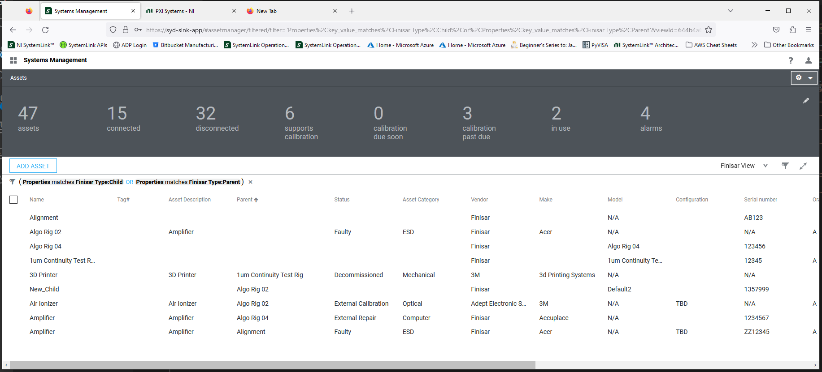
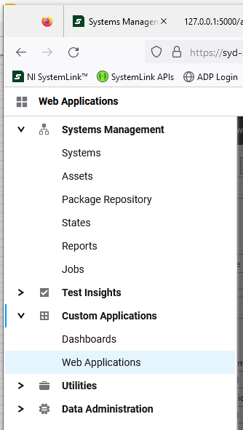
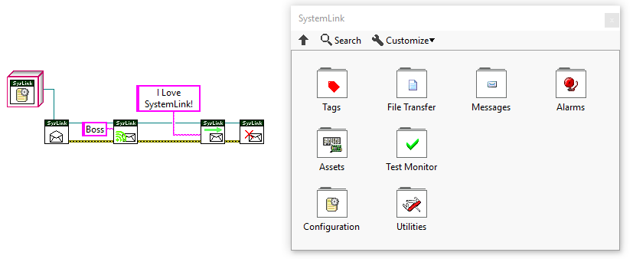
SystemLink – no but, what is it?
A server-side application with a web interface, and client-side software which allows LabVIEW & TestStand natively, and most other languages through APIs, to access useful services.

Slide 7
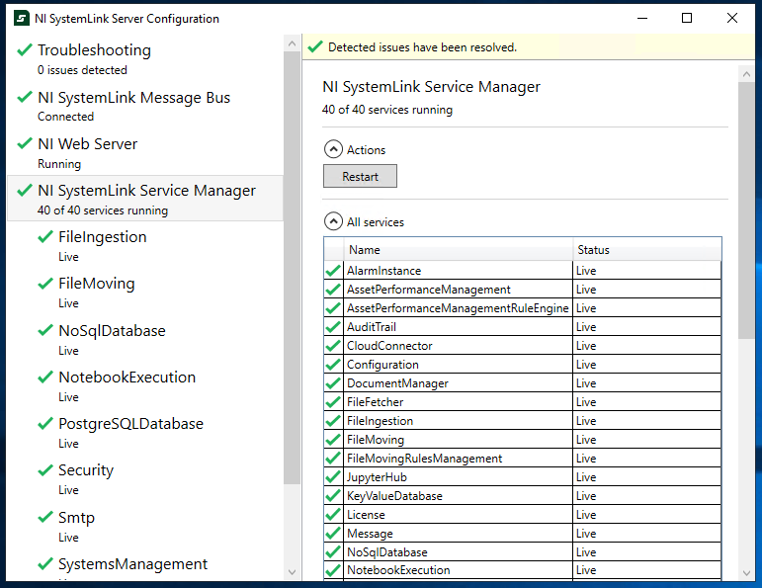
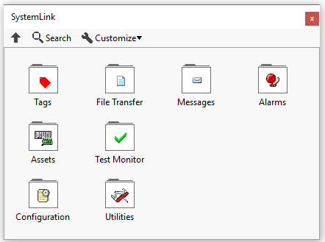
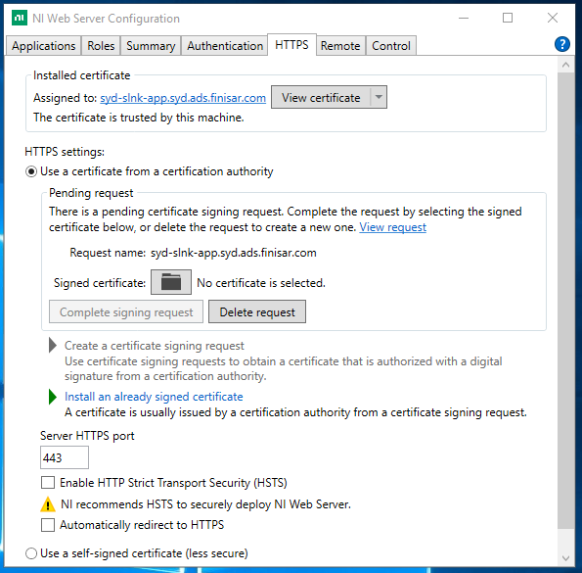
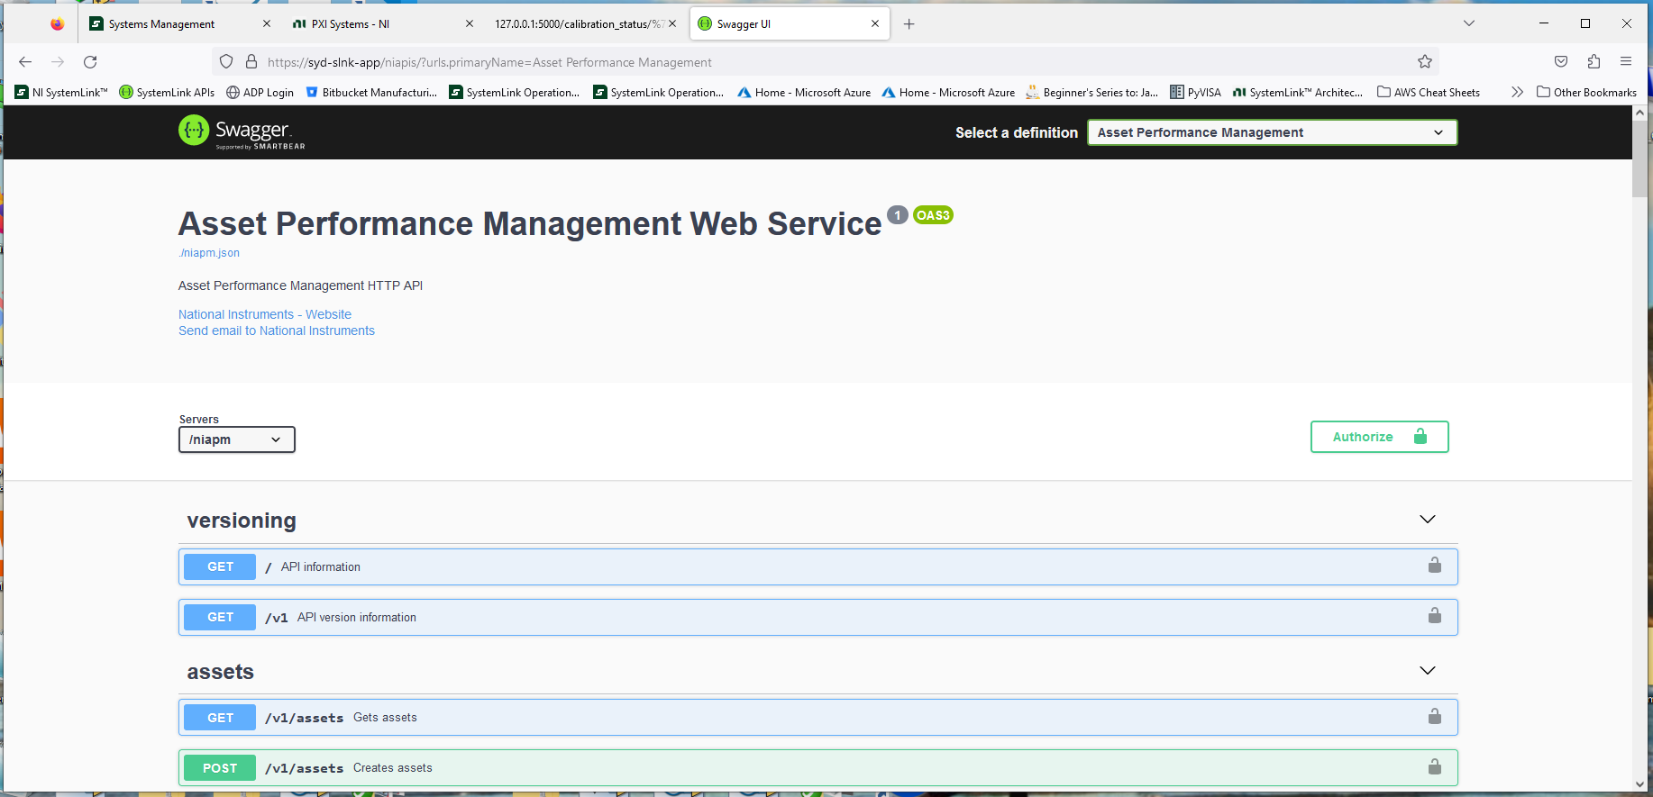
SystemLink – no but, what is it really?
A collection of 40 + web useful applications interacting with the NI web server to provide sanitized access to a NoSQL database via a suite of VIs or published APIs.

Slide 8
Web Applications
Browser Based Front End
LabVIEW API installed in a palette
API for other languages
SDK for other languages (Python)

Slide 9
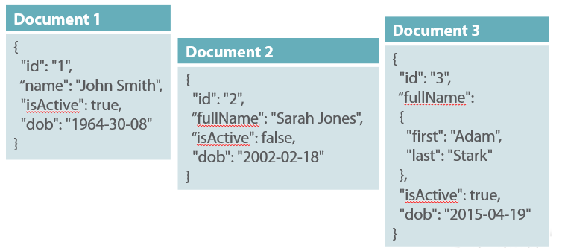
No … SQL, eh?
NoSQL is a schema-less non-relational database
Everything is stored as a document with JSON-style attributes
Not all documents have to have the same attributes populated at the same time – promotes flexibility!

Slide 10
Why is NoSQL better than SQL?
It’s not “better”, but for most of SystemLink functions the benefits are:
True “object” storage and retrieval – supports non-structured data such as binary files, video, audio.
Flexible and expandable “tagging” of objects, making searching much more flexible
Quick updates and simple, flexible Queries
Scales Horizontally – additional nodes or cloud-based

Slide 11
Why is NoSQL better than SQL?
It’s not, but for most of SystemLink functions the benefits are:
True “object” storage and retrieval – supports non-structured data such as binary files, video, audio…
Flexible and expandable “tagging” of objects, making searching much more flexible
Quick updates and Queries
Horizontal Scaling

Slide 12
So who’s using this NoSQL thing?
MongoDB which is installed with SystemLink boasts:
(www.mongodb.com)

Slide 13
Big Data, don’t we have lots of that?
Yes! All over the place in many formats:
But to get useful answers from it we often write bespoke LabVIEW software to
find it
mine it
clean it
analyze it
and finally present it.
By which time often the business has moved on and the problem has gone away. Or mushroomed.
Is there a better way?

Slide 14
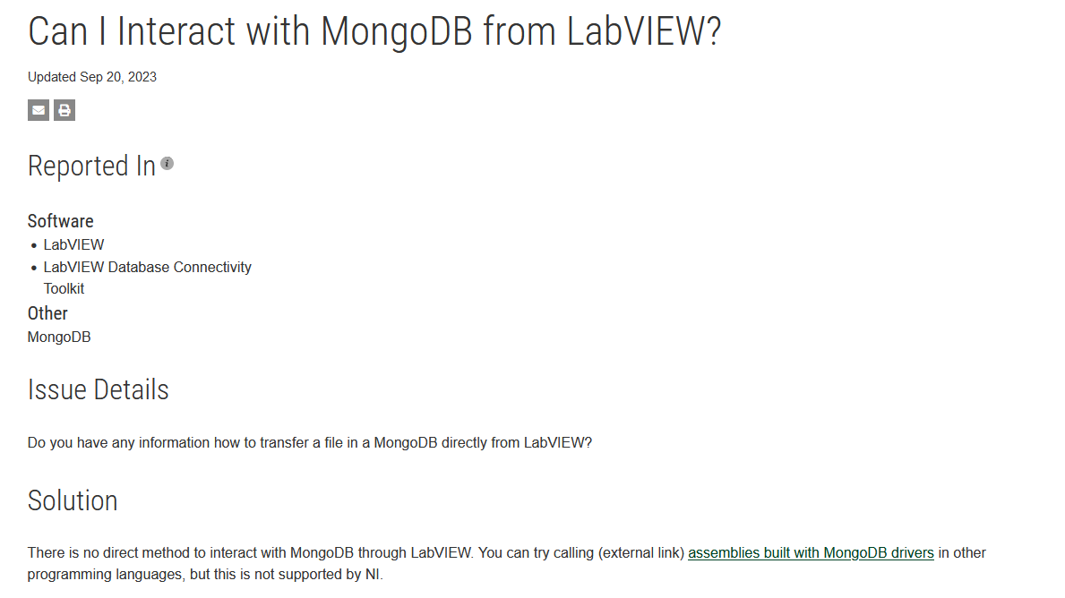
How do I access this wonderful new NoSQL in LabVIEW?
You can, but not natively (you’ll be using command line or C#)

Slide 15
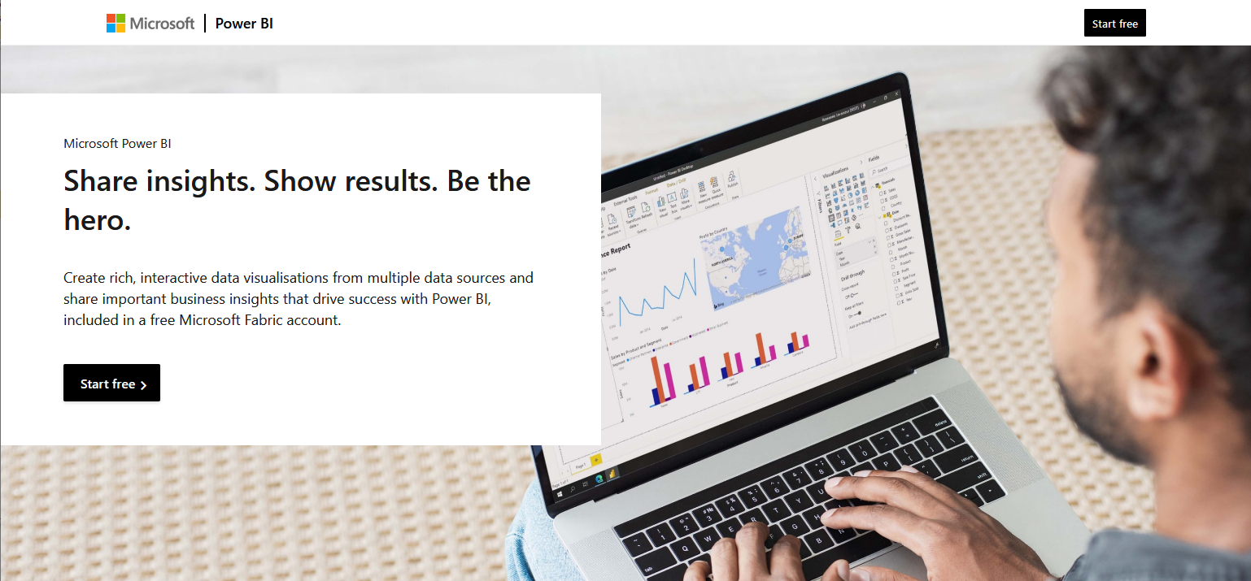
I got the Power (BI)
Business Intelligence systems allow even accountants to make sense of big data!
Look! I made a graph. Hang on, I made 2!

Slide 16
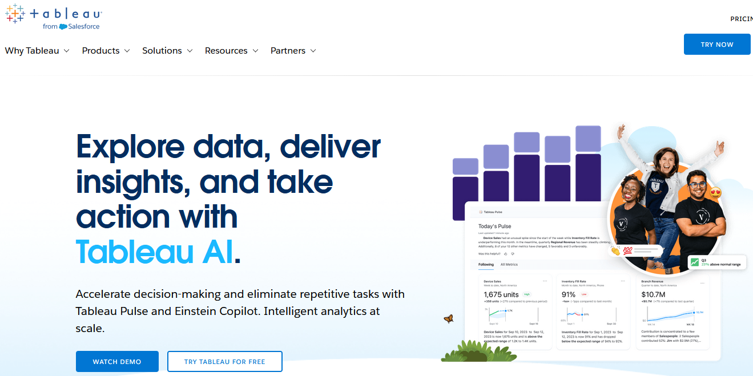
Microsoft? Bleurgh
There are other popular BI systems :
But is there one specifically designed around Engineering systems and data?

Slide 17
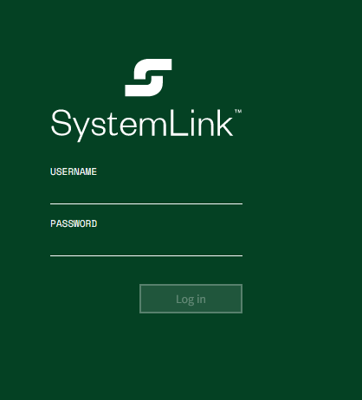
So, where can we find an off-the shelf easy, friendly, centrally controlled BI that “likes” LabVIEW for publishing, organizing searching, mining and generally being a big boss over test and measurement data which comes from a company we have history of dealing with and ordering from and also provides world-class amazing customer support?

Slide 18
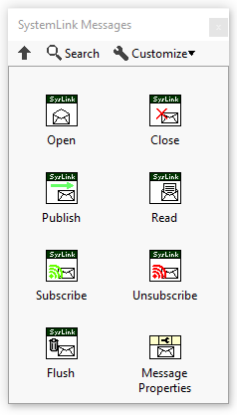
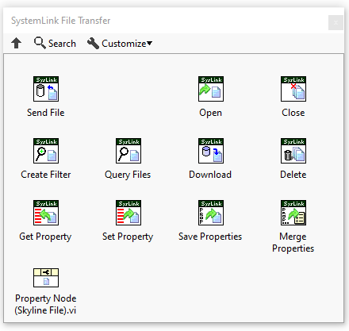
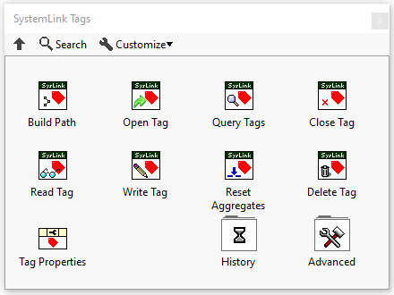
Native Types
Files
Tags
Messages

Slide 19
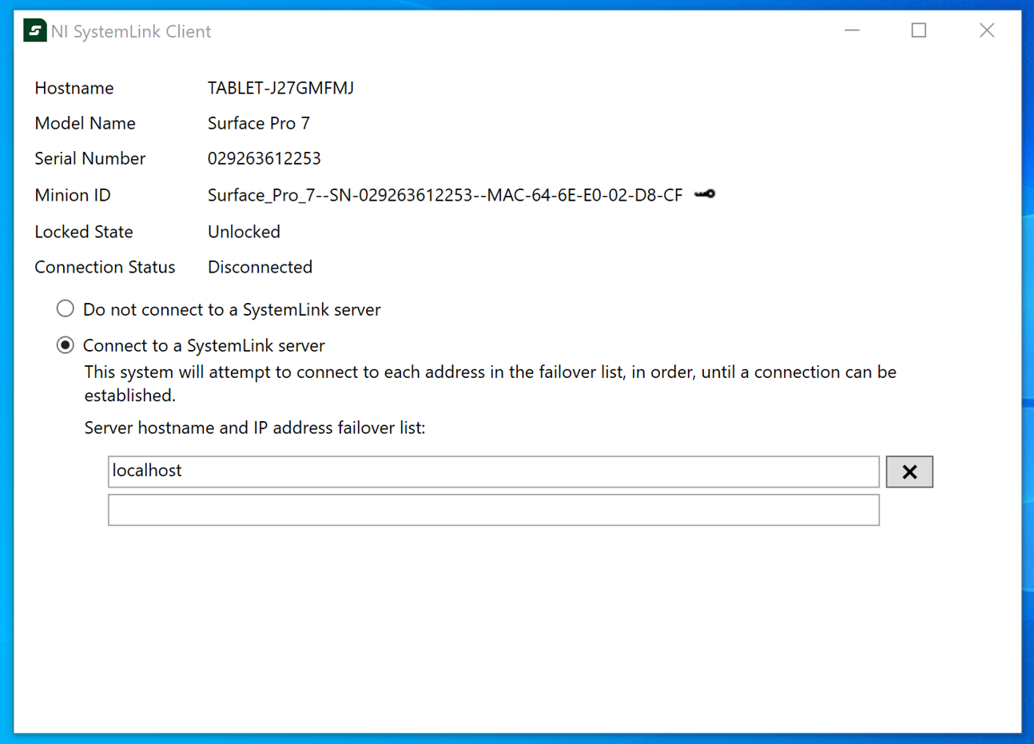
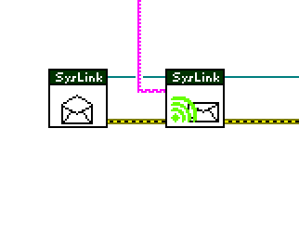
SystemLink Client
When SL client is installed and authenticated
LabVIEW knows how to connect automatically

Slide 20
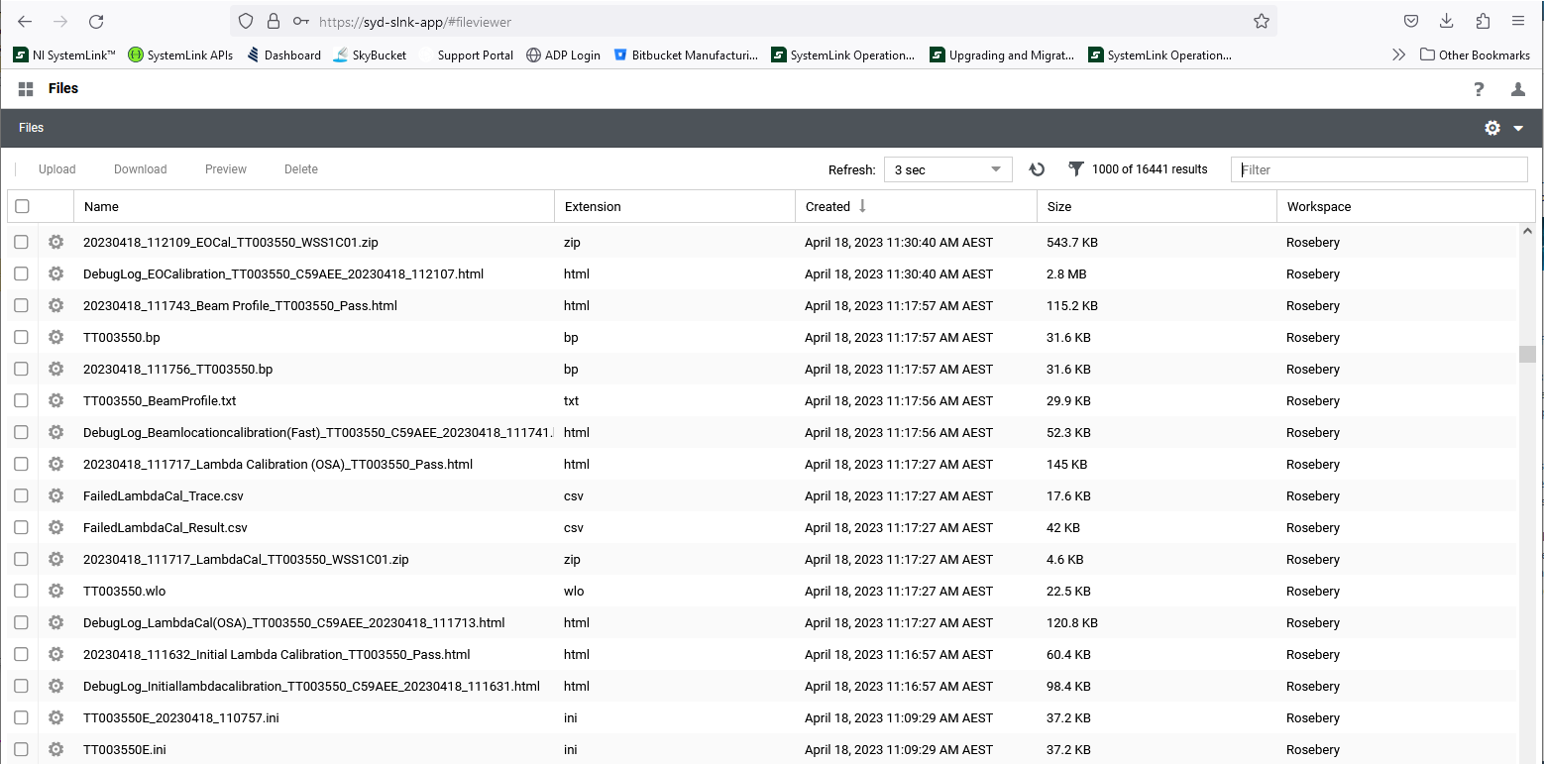
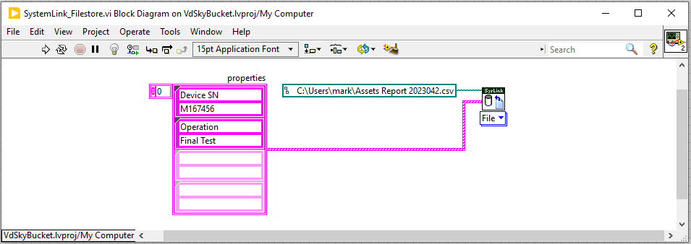
Filestore - Basic

Slide 21
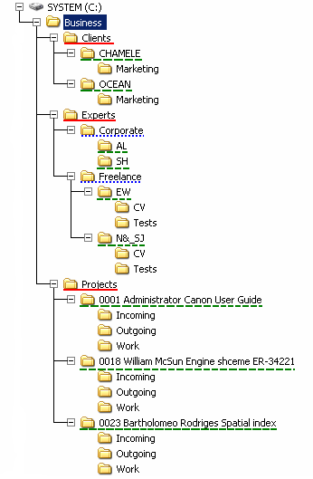
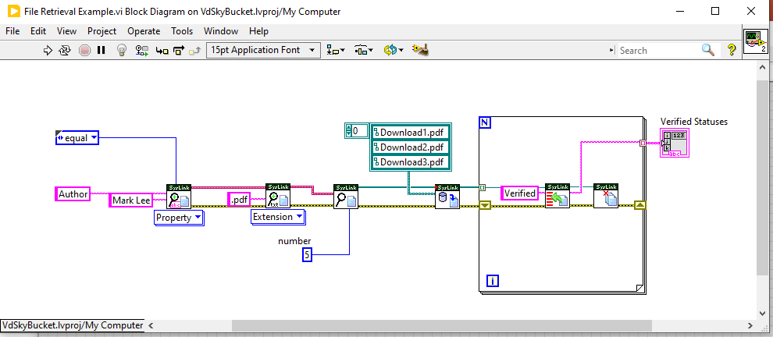
Look – no folder structure!
Documents in the NoSQL DB accessed by SystemLink aren’t organised in a file structure but are searched and accessed using their properties.

Slide 22
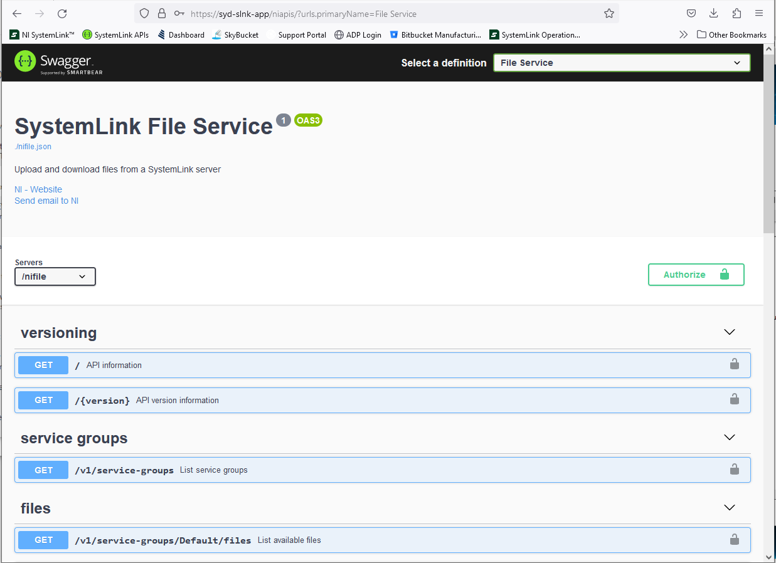
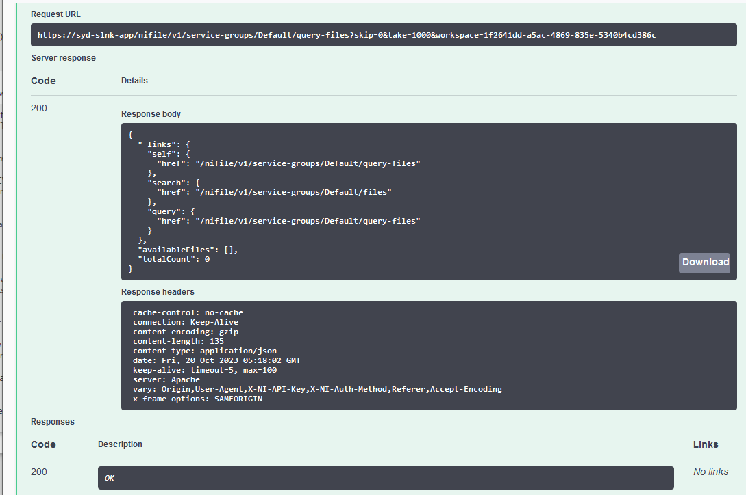
Swagger away

Slide 23
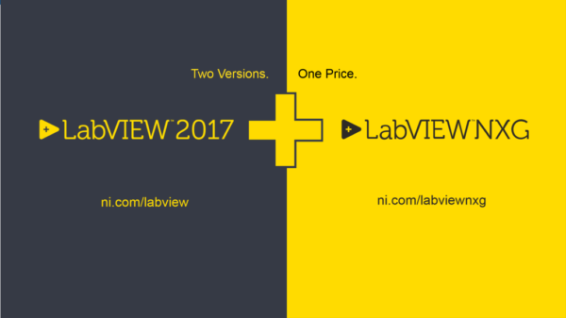
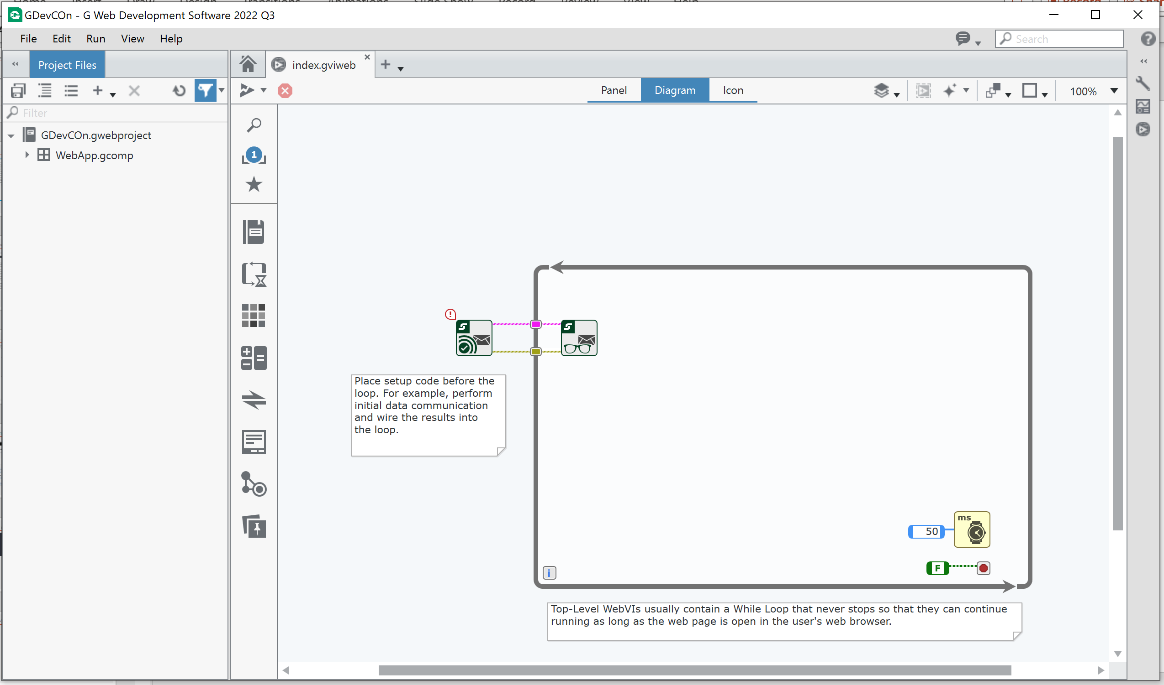
Make you own apps - Web VIs
Remember this guy?
G Web Development Software

Slide 24
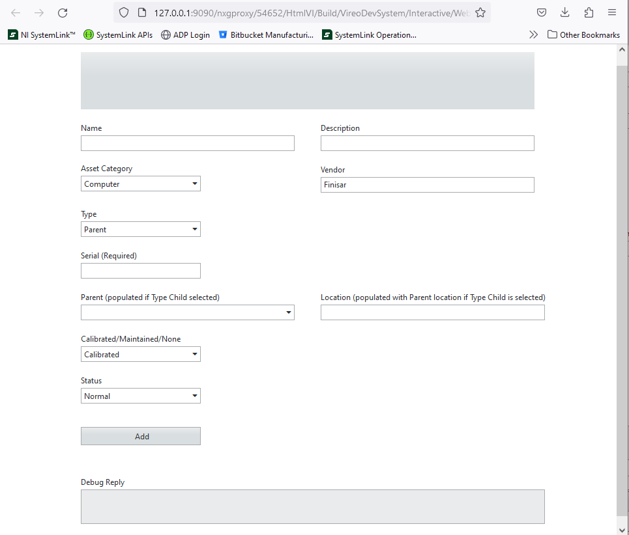
Web VIs

Slide 25
MicroServices
No native way to run LabVIEW code within SystemLink ☹
A wrapper can be put around LabVIEW code running on a separate “worker” server which accepts messages from SystemLink Messaging and controls when and how to run the VI
Message can RUN the VI
Message can POST information to the VI
Message can COLLECT information from the VI
This can break an application down into multiple microservices instead of 1 big monolith, by defining a consistent API and endpoints
VI(s) can then be mobile, move server or location
as long as the wrapper is subscribed to the SL ecosystem.

Slide 26
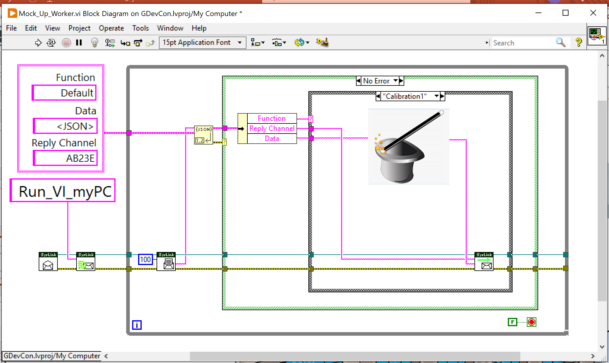
Worker structure

Slide 27
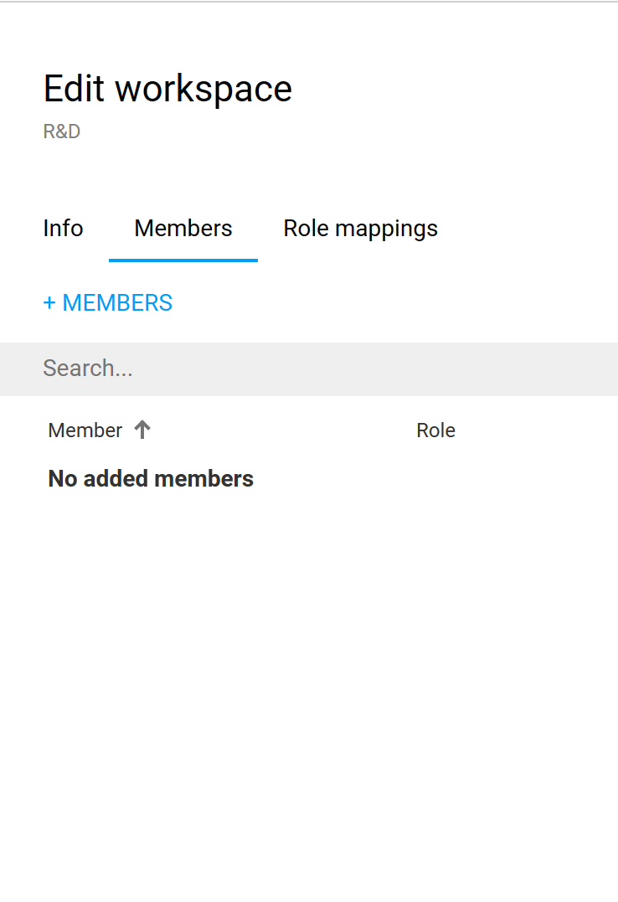
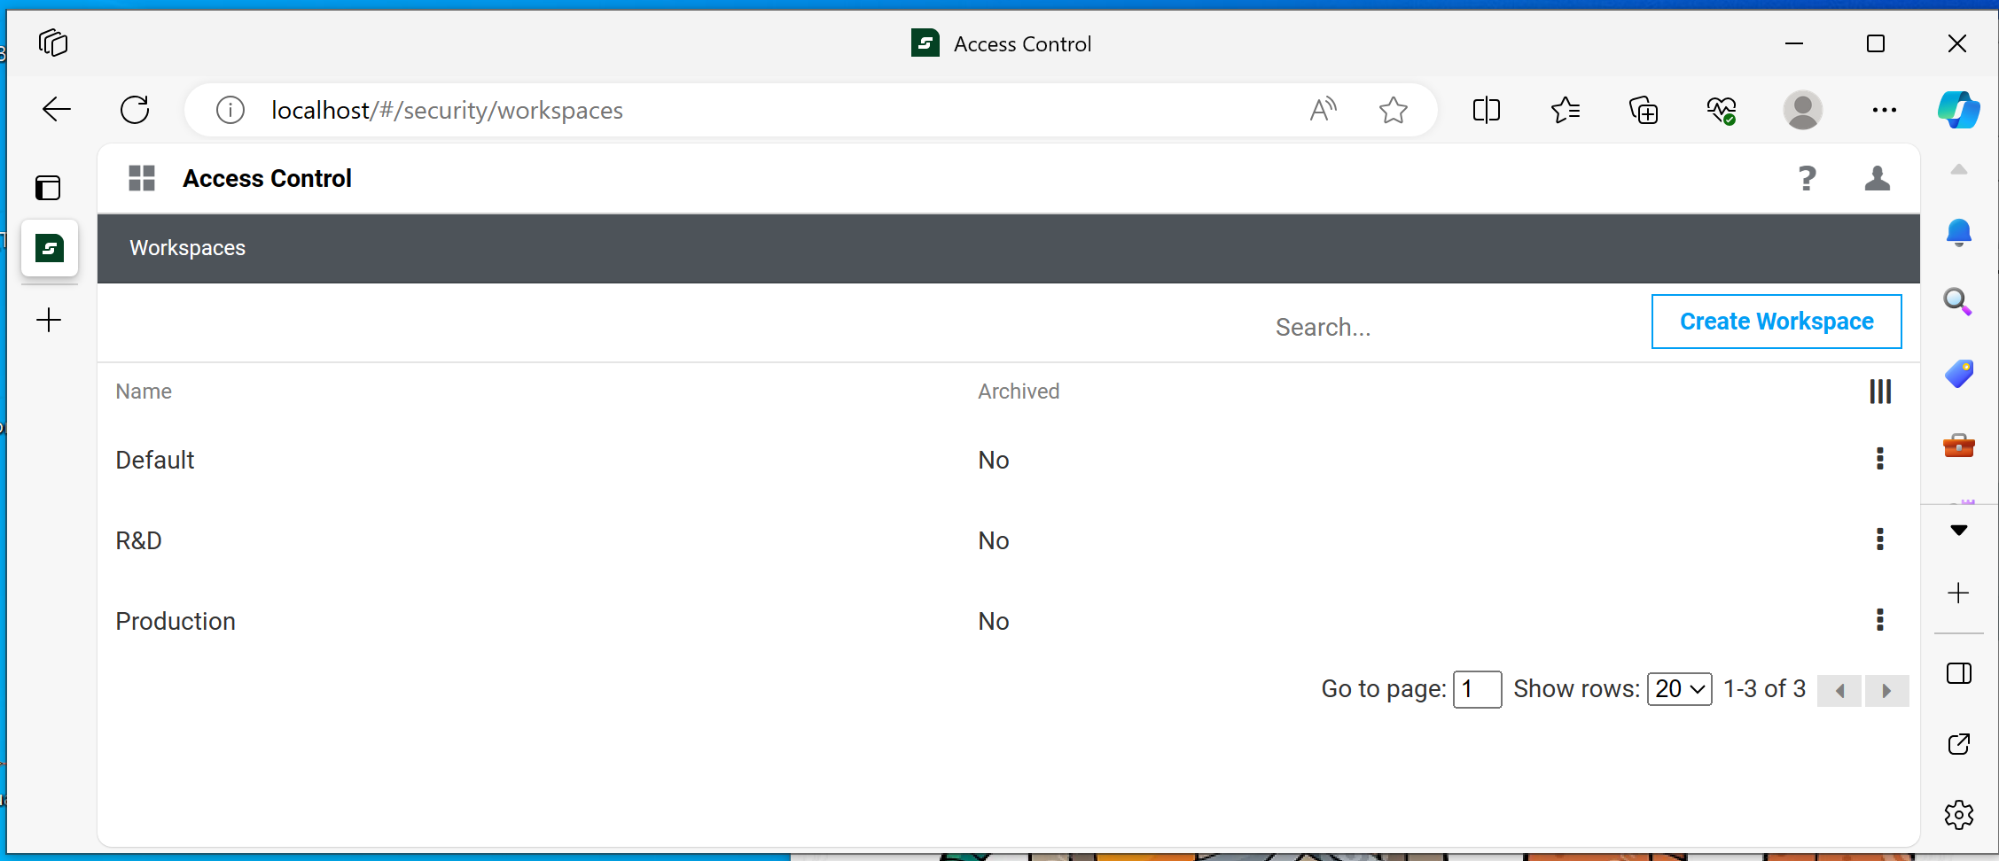
Workspaces
SystemLink Advanced function controls scope of data access to specific users
Sort Data by function:

Slide 28
Workspaces
SystemLink Advanced function controls scope of data access to specific users
Sort Data by Location

Slide 29
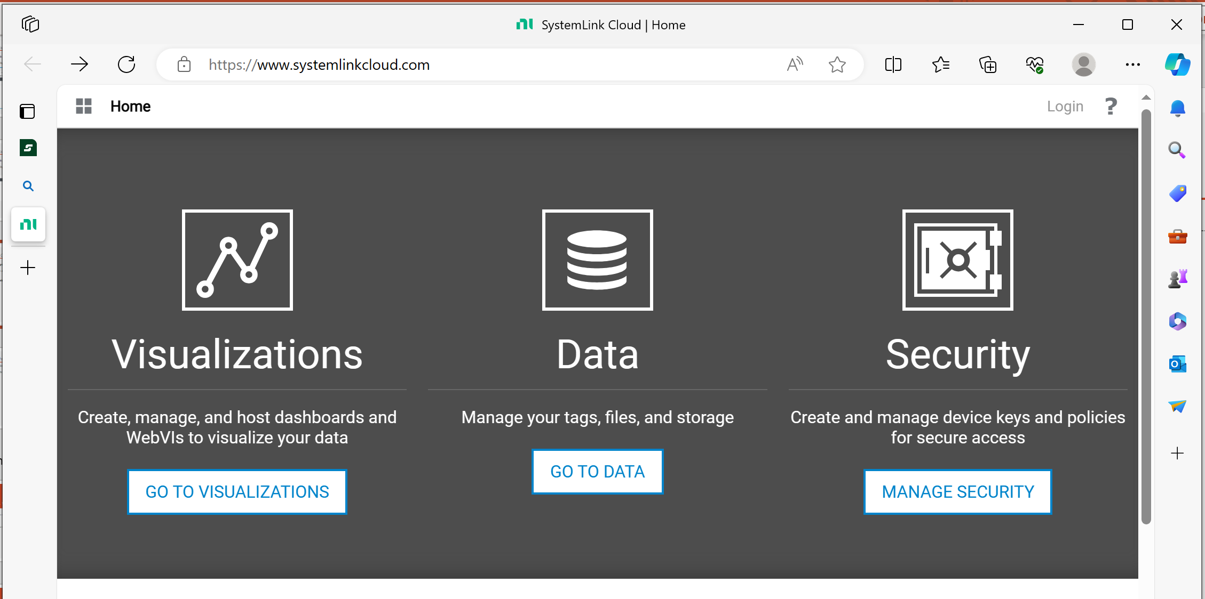
In The Clouds
SystemLink server can run on cloud providers EC2 instances or VMs
– although around 90% of new installations are on premise
SystemLink Cloud offers a lot of the functions of SystemLink server – accessed by API key

Slide 30
SystemLink Enterprise
New architecture designed around deployment to Kubernetes containers
Linux based
For large data sets and multi-region support in an enterprise environment

Slide 31
But … what does any of this have to do with bosses?
“I have never yet come across an engineer that can turn his hand to business.”
New Civil Engineer quotes Alan Sugar, The Apprentice UK, June 2011
(what about “her hand”???)

Slide 32
Harvard Business Review disagrees …
“Courageous leaders move past their insecurities regarding emerging technologies, unfamiliar jargon in the boardroom, or modifications to their leadership style. They adopt an opportunity-oriented mindset by understanding how CLS (Computational Leadership Science) boosts their performance.”
“CLS is … designed to fundamentally improve leadership by using simulations, network analysis, AI and other computational approaches … at the intersection of trailblazing science and technology.”
“Netflix … blends sophisticated viewer analytics with years of experience when exploring new products.”
“… the days of purely intuitive decisions are over.”
Harvard Business Review, “How Data Can Make Better Managers” Brian Spisak, 2022

Slide 33
Cost Benefits
Data generated by processes and engineering is priceless to organizations.
Answers to complex problems are required much faster.
Untrained people (bosses) need access to speedy answers….
Data storage needs flexibility, scalability and accessibility

Slide 34
Experiment and Have Fun!

