Slide 1
for Software Deployment & Configuration Management
Anoop Nandakumar
25/10/2023

Slide 2
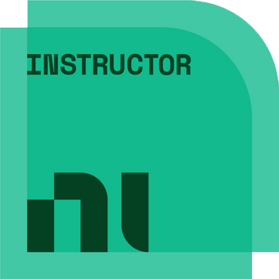
Meet the presenter
Anoop Nandakumar
Projects & Operations Manager CPE Systems NZ Ltd Auckland, New Zealand
Notes:
Thanks for letting me present
Really good meeting all of you here.
Work for CPE Systems NZ
LabVIEW since 2010
TestStand since 2014
SystemLink since 2018
CLD, CPI
Refer Mark

Slide 3
#OurGiantsAreFemale
Geetha Nandakumar

Slide 4
Agenda
Background​
Challenges of Deployment and Configuration Management of Production Test Systems
Tools and Processes out there
Advantages of using NI Package Builder and SystemLink
Prerequisites and Setup
Demo
Challenges and Issues
Key Takeaways
Q & A

Slide 5
Background
Deployment challenges begin soon after software is released; including-
Software bugs
Requirement(s) updates
Hardware and Firmware changes
Hardware Failure
Software version management, compatibility issues, remote deployment, language and travel restrictions add to the above challenges.
Notes:
Background –
You might use tips Nick mentioned to code faster, Chris’ techniques to make your code run faster and Chris’s quality checks and we release the software to be deployed.
Link from Development to deployment
Sign-off of a system. – Everything is ‘good’
Then things change after deployment. Typical lifecycle management
Bug fixes
Hardware and Firmware Changes – Driver updates
Hardware failure – PC, Instruments
Firmware changes
Specs changes.

Slide 6
Case Study – Production Test Systems
Specific deployment issues
Multiple programming languages
Hardware from various manufactures
DUT variants
Overseas contract manufacturers
Multiple production sites and test stations
Roll-back and recovery
Notes:
For the purpose of this presentation, let us use production test systems as an example
TestStand with underlying drivers, third party hardware and software
TestSteps could be in LabVIEW, Python etc…
Hardware from Keysight, NI, BK Precision etc.
Multiple DUT types and variants can be tested in a single production site

Slide 7
Processes and Software Tools
Manual
Time consuming
Highly prone to errors
Time zone Lags / Might include travel
Atlassian Jira, Bamboo, Confluence
Software development and deployment management tools
Not designed for Test and Measurement Systems
Notes:
SVN, Git
Atlassian tools like
TestStand Deployment utility
Manual processes copy-paste

Slide 8
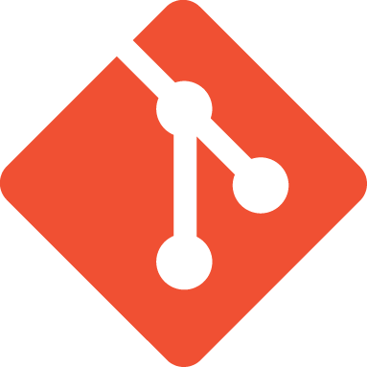
Processes and Software Tools
SVN and Git
Primarily Software development version control tools
Higher chance of accidently exposing source code
Can’t automate installation of drivers and supporting software
NI TestStand Deployment Utility
*.msi installers
File path and dependency issues are common
Versioning and updates are hard to manage
Slow
Not easily reproducible
Notes:
SVN, Git
Atlassian tools like
TestStand Deployment utility
Manual processes copy-paste

Slide 9
Advantages of NI Package Builder + NI SystemLink
Reproducibility
Dependency Management
Scripting Support
Include Third-Party Software
Version control locally in NI Package Manager
Centralized monitoring and management
Remote Deployment
Version control across multiple systems
Scalability
Integration with other platforms & tools
+++Get Test Information from Data
Notes:
The NI Package Builder offers several key advantages over the TestStand Deployment Utility. Here are some of the advantages:
Customization: NI Package Builder allows for highly customizable software package creation. You have more flexibility in defining the content, structure, and behavior of the package. You can include additional files, configure installation options, and specify pre- and post-installation actions.
Reproducibility: With NI Package Builder, you can create packages that are reproducible, meaning you can recreate the exact same package with the same content and behavior. This is useful for version control and maintaining consistency across deployments.
Dependency Management: NI Package Builder supports dependency management, allowing you to specify dependencies on other software components or libraries. This ensures that all required dependencies are included in the package, simplifying the deployment process.
Scripting Support: NI Package Builder provides scripting support, allowing you to automate the package creation process. You can use scripts to define complex installation workflows, perform custom actions, or include additional customization.
Integration with Other NI Tools: NI Package Builder seamlessly integrates with other NI software tools, such as LabVIEW and TestStand. This integration allows you to easily create packages from LabVIEW applications or TestStand sequences, leveraging the capabilities of these tools.
Distribution and Installation: NI Package Builder generates installer files that can be easily distributed and installed on target systems. The generated installers provide a user-friendly installation experience, including options for customization and configuration.
Support for Multiple Platforms: NI Package Builder supports the creation of packages for multiple platforms, including Windows, Linux, and macOS. This allows you to create packages that can be deployed on different operating systems.
Overall, the NI Package Builder offers greater customization, reproducibility, dependency management, scripting support, integration with other NI tools, and multi-platform support compared to the TestStand Deployment Utility. These advantages make it a powerful tool for creating software packages and simplifying the deployment process.
The NI SystemLink Software Management modules offer several key advantages over the TestStand Deployment Utility. Here are some of the advantages:
Centralized Management: The SystemLink Software Management modules provide centralized management for software deployment, updates, and configuration across multiple systems. This allows for easier control and coordination of software versions and configurations.
Remote Deployment: With SystemLink, you can remotely deploy software to multiple systems without the need for physical access to each individual system. This saves time and effort, especially in large-scale deployments or when dealing with geographically dispersed systems.
Version Control: SystemLink enables version control of software packages, allowing you to easily manage and track different software versions. This helps ensure consistency and reliability across your deployment environment.
Monitoring and Diagnostics: The SystemLink Software Management modules provide monitoring and diagnostics capabilities, allowing you to track the health and performance of your deployed software. This helps in identifying and resolving issues proactively.
Integration with Other NI Tools: SystemLink seamlessly integrates with other NI software tools, such as LabVIEW and TestStand. This allows for a more cohesive and integrated software management experience, leveraging the capabilities of multiple NI tools.
Scalability: SystemLink is designed to scale with your needs, supporting deployments ranging from a few systems to enterprise-level deployments. It offers flexibility and scalability to adapt to changing requirements.
Overall, the NI SystemLink Software Management modules provide a comprehensive and powerful solution for software management, offering centralized control, remote deployment, version control, monitoring, diagnostics, and integration capabilities. These advantages make it a valuable alternative to the TestStand Deployment Utility, particularly for larger and more complex software deployment scenarios.

Slide 10
Prerequisites and Setup
Terms
Package
Package Dependency
Feed
Repository
Package Installer
Notes:
Package
A package is a single, compressed file containing both software intended for installation on a target machine and a collection of files and metadata for how to install and uninstall the files.
Package dependency
A package dependency defines how a package relates to another package. For example, a package can require that another package is already installed in order to install, or a package can recommend or suggest installing another package. This
relationship can also be constrained by version.
Feed
A feed is a collection of package locations that includes a manifest containing information on the included packages. The packages referenced in a feed are set up to satisfy all dependencies required for the installation of the packages. NI
recommends using feeds when distributing multiple packages that have dependencies on one another. You can register feeds with Package Manager, which allows users to select specific products to install.
Repository
A repository is one or more feeds and the package files referenced by the feed(s). A user that has Package Manager configured to include the repository as a feed will see the repository packages in the Packages tab and updated packages in the
Updates tab.
Package installer
A package installer is a folder that contains an installer executable, one or more feeds, and (optionally) co-located packages under the folder. When you run a package installer, Package Manager (1) installs or updates if necessary, (2) registers
the feeds to facilitate installing its specific set of packages, and (3) starts the installation wizard. The installation wizard might prompt you to select the product packages to install, then might prompt with additional recommended and
suggested packages to install.

Slide 11
Prerequisites and Setup
Software Setup
NI Package Manager
NI Package Builder
NI SystemLink Server
SystemLink Client(s)
And some patience…

Slide 12
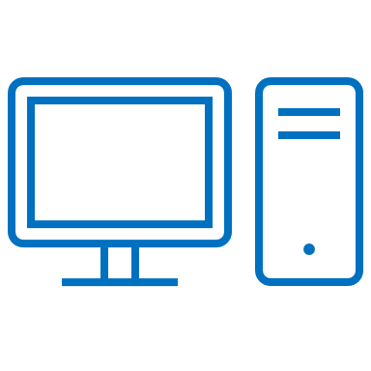
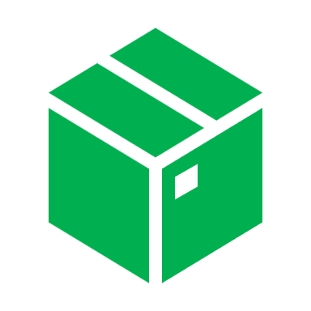
Process Flow
Notes:
Start with TestSystem
Packages
SystemLink
(Add Diagram)

Slide 13
Demo
Notes:
Demo based Eroad
Partial deployment –
ABB and HJ
Garmin for 5 years

Slide 14
Challenges for adoption
​
Cost
IT hurdles
Investment in Legacy Processes
SystemLink Teething Issues -
Stability
Documentation (lack of)
Support
Notes:
IT
Investments in Lagacy systems is a inhibitor
Stability
Support, Documentation

Slide 15
Key takeaways​
Is it of value?
Yes, NI Package Builder adds value
Adding SystemLink to scale and manage multiple systems remotely amplifies the value
Managed gateway between development and deployment
Part of the process, not THE solution
Adoption challenges
Managing the IT departments of this world
Notes:
Garmin deployment
Adding this process at the right level
Rollback
Make sure the software, drivers are compatible
E.g. Issue with the using future run-time engines with LabVIEW libraries

Slide 16
Q & A

Slide 17
Thank you
Anoop Nandakumar
anoop@cpesys.co.nz​
CPE Systems NZ

